Slide 1
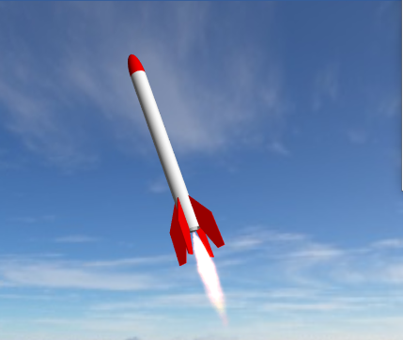
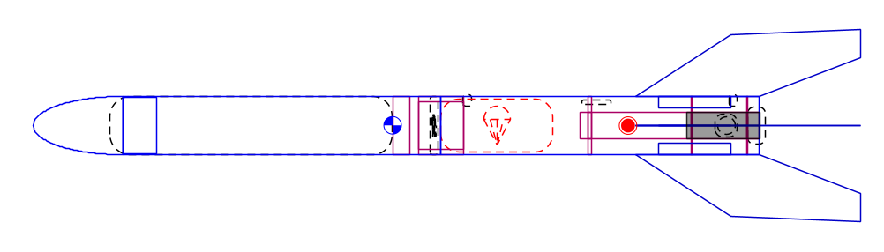
Simulating Rocket Flight with OpenRocket

Slide 2
Background and Objective
The performance of the rockets you will launch can be accurately predicted using OpenRocket.
We will use OpenRocket to make predictions before your rocket launch.
The “core” of OpenRocket are models that can be replicated in Excel.
We will examine Excel performance estimates after your rocket launch.

Slide 3

OpenRocket
“OpenRocket is a free, fully featured model rocket simulator that allows you to design and simulate your rockets before you build and flying them.” https://openrocket.info/
You will use OpenRocket version 22.02 to predict the performance of your rocket.

Slide 4
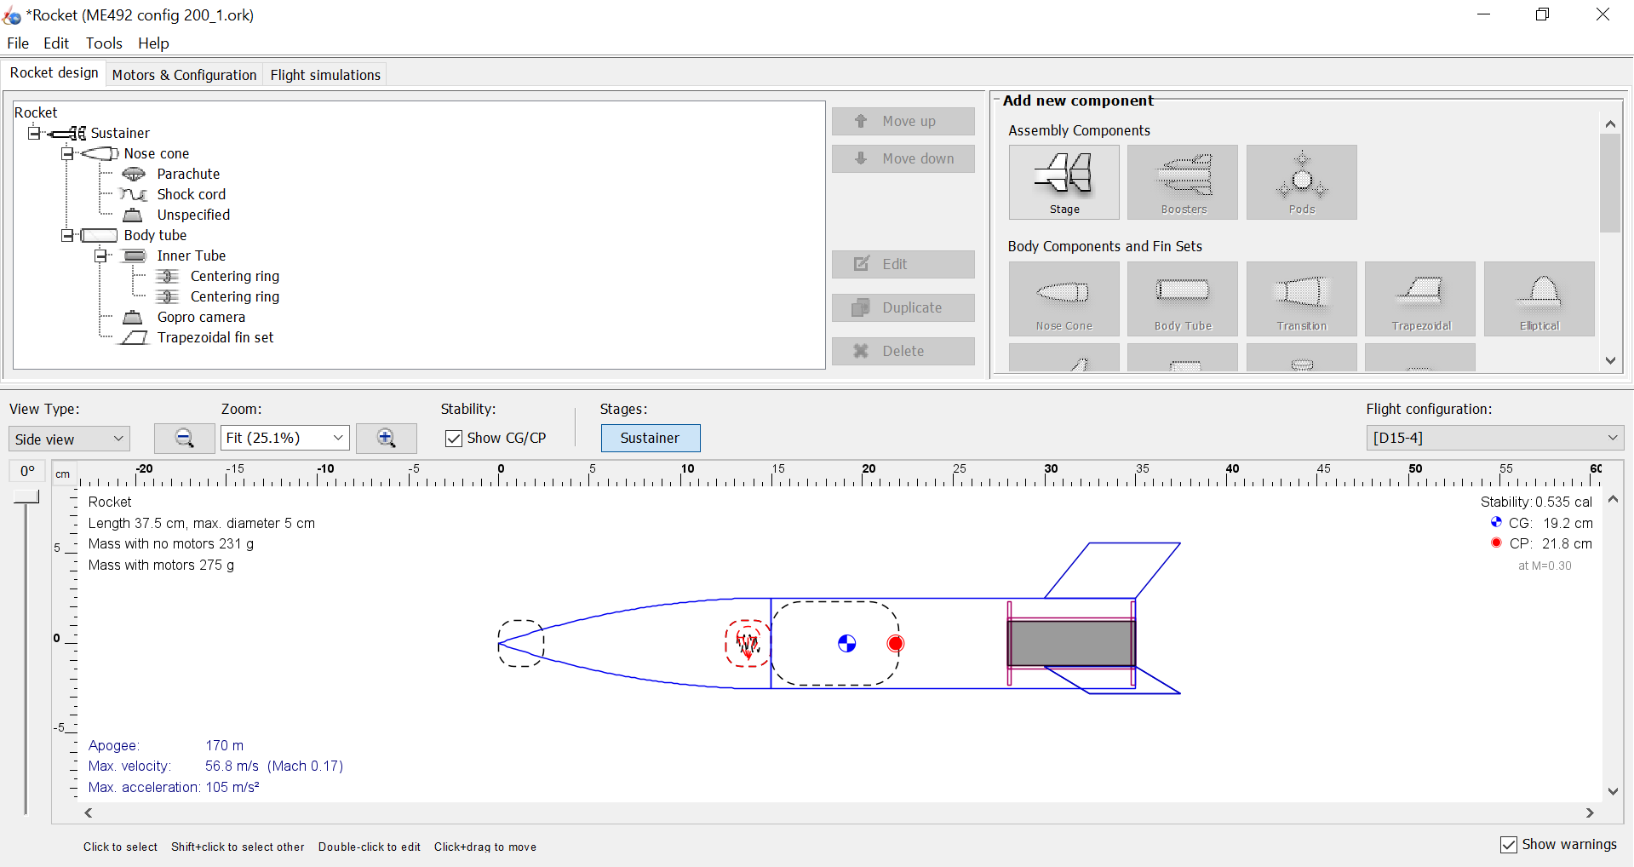
OpenRocket – Walk Through and Example Build
As an example of OpenRocket, we will build a simple rocket.

Slide 5
OpenRocket – The Single Stage Rocket
The rocket you will be building and launching has more features and detail than the example rocket we just created.
You and your students will be provided the model for the rocket that you will be launching.
Using the rocket provided, you can predict the performance of the rocket.

Slide 6
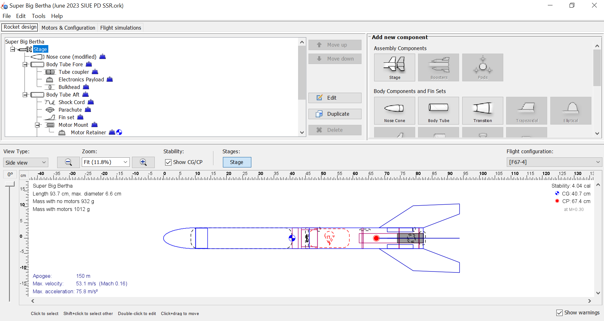
Single Stage Rocket Design in OpenRocket

Slide 7
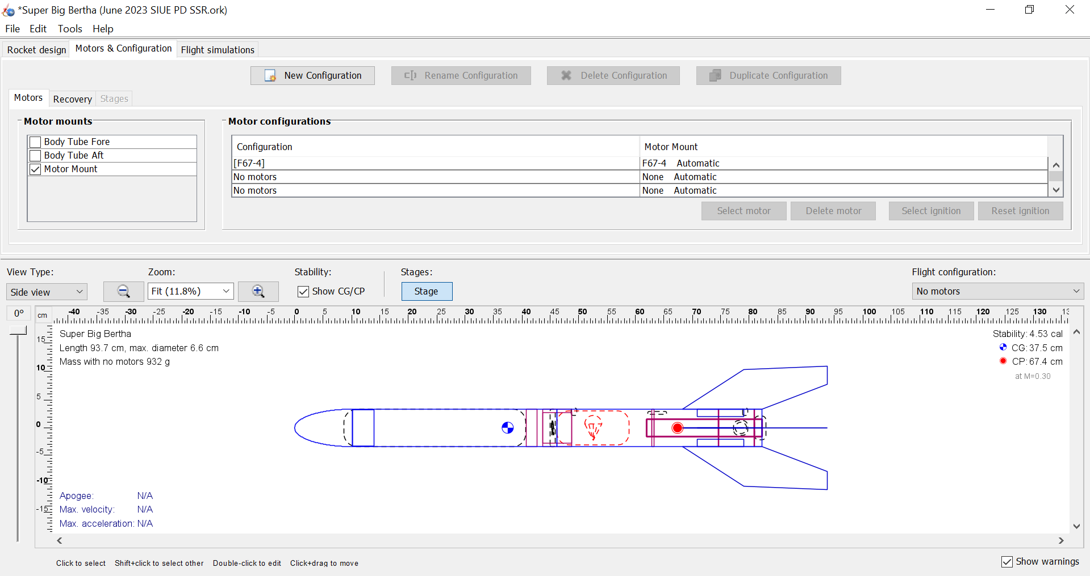
SSR Motor Selection in OpenRocket

Slide 8
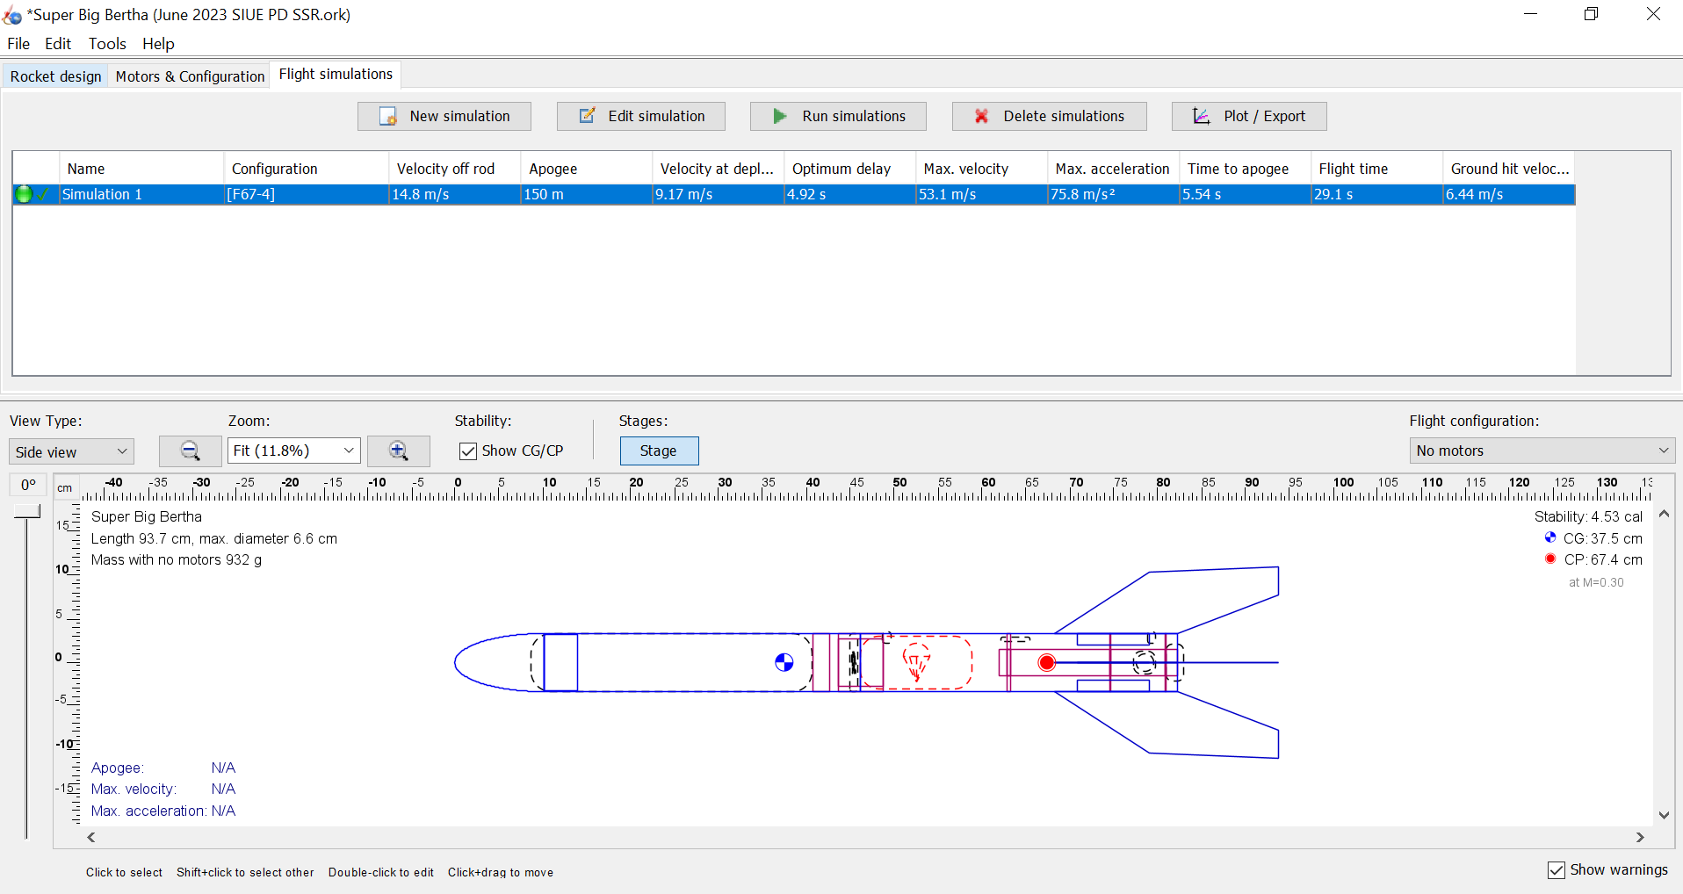
SSR Flight Simulation in OpenRocket

Slide 9
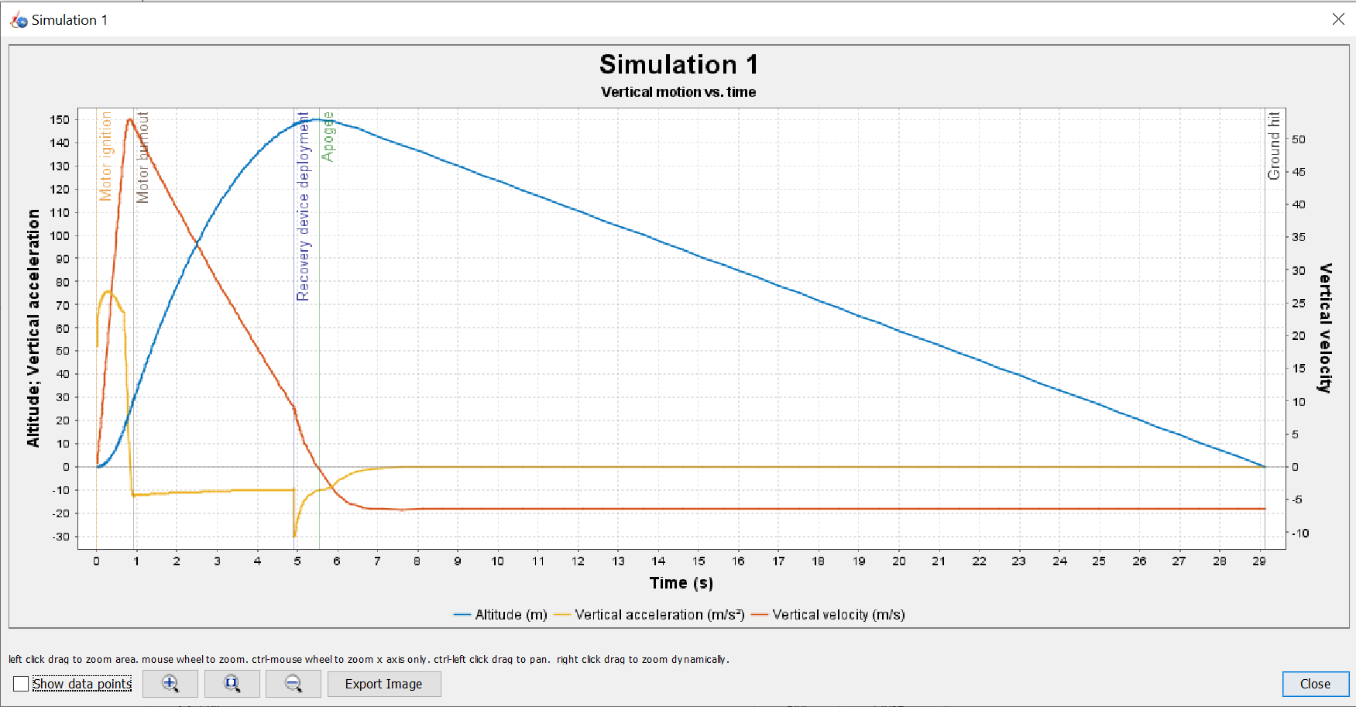
SSR Simulation Plots in OpenRocket

Slide 10
Rocket Payload Study
One method of varying the rockets between teams is to have each team carry a different payload mass.
The heavier the payload, the lower the apogee. This can be predicted using OpenRocket.
We will launch rockets with different payload. The payload for your rocket will be identified.
Since our rockets are already very stable (i.e. the CG is well forward of the CP), we will add the mass to the back of the rocket.
Once your payload has been assigned, modify your OpenRocket file to assess the change in apogee for the payload.
Record your rocket’s apogee and velocity off the launch rail.

